Slide 1
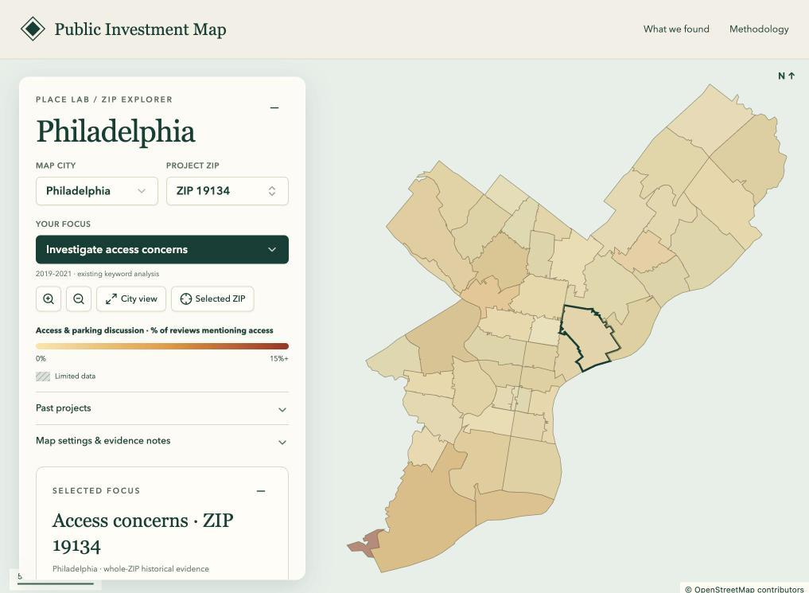
CIS 509 · Analytics for Unstructured Data · Team 4
Place Lab
Better local evidence
for public planning
John Wheeler · Ryan Wolff · Cameron Anthony
October 2026
Notes:
Ryan
Hi everyone. We’re Team 4, and our project is called Place Lab.
We help planners understand an area and explore what happened around past public investments.
We combine historical Yelp reviews, Census data, and public project records in an interactive map.
I’ll introduce the problem, our data, and how we turn that information into evidence users can explore.

Slide 2
PROJECT HYPOTHESIS
Better area data helps identify local needs
Public officials
Investment
developers
Investors
Identify community needs
and focus public investment.
Understand local needs
before proposing a project.
Assess local context and
questions worth investigating.
Place Lab helps investigate local needs
Explore area conditions, review local experiences,
and compare evidence around past projects.
2
Notes:
Ryan
Our hypothesis is that better local information can help identify community needs.
Public officials could use it to focus investment.
Developers could understand an area before proposing a project.
Investors could identify questions worth investigating.
Place Lab connects area conditions, experiences described in reviews, and evidence from past projects.
This is our proposed value. We haven’t yet evaluated whether it improves real-world decisions.

Slide 3
WHAT PROBLEM ARE WE SOLVING?
Procurement takes time. Public data can inform decisions earlier.
NYC FY2026 · median procurement cycle
Explore early
Use available evidence to screen areas.
Competitive
sealed bids
282 days
Refine the question
Identify what still needs investigation.
Competitive
sealed proposals
527 days
Narrow the request
Specify the data or analysis to commission.
Citywide contract categories; data-only delays are not measured.
Our goal: better evidence before investment
Use public data to focus the next investigation.
Sources: NYC MOCS FY2026; Federal Data Strategy; FAR 12.202. Links and scope in notes.
3
Notes:
Ryan
Getting additional data or analytical services can take time.
New York City reports median procurement cycles of 282 days for competitive sealed bids and 527 days for competitive sealed proposals.
That’s roughly nine and seventeen months.
These are broad contract categories, not specifically data purchases.
Place Lab could help planners explore available evidence, identify what’s missing, and define a more focused research request.
We haven’t measured time savings. Our goal is to help planners start with better questions.

Slide 4
WHAT PROBLEM ARE WE SOLVING?
Only about 3 in 10 reviews mention the surrounding place
200 randomly sampled reviews
61 of 200
Place mentioned
61
The relevant signal is mixed with food, service and business feedback.
No place mention
139
4
Notes:
Ryan
Business reviews don’t always tell us about the surrounding area.
In our random sample of 200 reviews, 61 mentioned the surrounding place.
Most focused on the business itself.
A complaint about food tells us something different from a complaint about the sidewalk outside.
Claude Opus generated these labels, and our team reviewed them.
This is a sample estimate, not a measurement of the entire dataset.
That’s why we need NLP to identify what a review describes before interpreting its sentiment.

Slide 5
PIPELINE / 01 · PREPARE THE DATA
Join each source at the scale it actually describes
1M
196
2
11
TECHNICAL CHOICES
Join key
Review-to-business link.
ZCTA
Census ZIP display area.
Distance bands
Near ≤500 m; comparison
1.5–8 km.
Memberships
Score once; retain shared
project assignments.
distinct project
reviews
ZIPs in
5 metros
ACS
measures
past
projects
Score once; retain shared memberships
Census ZCTA boundaries
Historical income and poverty
7 cities; dates, costs and footprints
Area path: ZIP / ZCTA
Project path: distance
Join reviews by business ID and ZIP; add ACS context.
Apply distance bands and predefined opening windows.
5
Notes:
Ryan
We organize the data into two paths.
The area path connects reviews to businesses and ZIP codes, then adds historical Census income and poverty data.
It covers 196 ZCTAs across five metro areas. ZCTAs are Census approximations of ZIP codes.
The project path groups businesses by distance from a project and reviews by time before or after opening.
It covers 11 projects across seven cities and just over one million distinct reviews.
We score each review once while retaining its connections to multiple projects.
The paths cover different populations. Census measures describe the area, not individual reviewers.

Slide 6
PIPELINE / OVERVIEW
From historical data to explorable local evidence
Research checks
TF-IDF / NMF
BERTopic · BERT
Area measures
ZIP aggregates
ACS context
Place Lab
Map · evidence · history
Sources
Yelp reviews
ACS + ZCTA
Project records
Join + score
Cohorts · VADER
Clause / mention rules
Validate + export
Six static data files
Build hashes
Project outcomes
Near vs comparison
Pre / post windows
Model evaluation
Project / city holdouts
Timing sensitivity
6
Notes:
Ryan
This diagram shows how the pieces fit together.
We join reviews to businesses, locations, and dates.
VADER scores sentiment, while text rules identify relevant mentions.
The area path produces ZIP-level measures with Census context.
The project path compares nearby and farther businesses before and after a project opens.
The dashed branch shows research checks, including topic models and a BERT-embedding classifier. The app still uses the rules.
Python validates the results and exports six data files for Place Lab.
These comparisons reveal patterns, but don’t establish causation.
Handoff: “Cameron will now explain how we separate business feedback from comments about the surrounding place.”

Slide 7
PIPELINE / 02 · EXTRACT PLACE MEANING
Split the review before deciding what it describes
ILLUSTRATIVE REVIEW · SPLIT AT “BUT”
“The staff were rude, but the park across the street is lovely.”
TECHNICAL CHOICES
Clause splitting
Separate parts of a review.
Keyword rules
Match topic vocabularies.
Target assignment
Area, business or unclear.
VADER
Lexicon + rules for tone;
complaint phrases refine it.
“The staff were rude.”
“The park across the street is lovely.”
Topic: food / service / value
Target: business
Polarity: negative
Topic: public space
Target: area
Polarity: positive
Extract topic, target and polarity for each clause.
7
Notes:
Cameron
3:20–4:25. Walk through the illustrative review sentence. Split at punctuation and conjunctions such as but, however and although. Match the nine versioned topic vocabularies. Assign business, area or unclear from explicit business/outdoor context; transit and public walking infrastructure can imply an area target. Score the whole review and each selected clause with VADER; clause polarity also checks complaint expressions and explicit negation. A topic mention is not necessarily a negative area complaint. Aggregate review flags once even when multiple clauses match. The displayed sentence is illustrative, not an attributed source quote. Rules are deployed in project evidence; map access mentions come from separate overlapping whole-review keyword rules. Source: project_text.py and build_review_topics.py; notebook §5.3.

Slide 8
PIPELINE / 03a · DISCOVER PATTERNS IN EXTRACTED TEXT
BERTopic groups recurring language in place excerpts
How clusters are formed
Themes in 413 excerpts
TECHNICAL CHOICES
MiniLM
384-dimensional
sentence vectors.
UMAP
Reduces dimensions.
HDBSCAN
Groups similar vectors;
keeps some unclustered.
c-TF-IDF
Distinctive cluster terms.
MiniLM embeddings
UMAP reduces dimensions
HDBSCAN forms groups
c-TF-IDF describes them
Parking
84
Neighborhood / night
22
Parks / water
19
Walking / distance
13
Streetcar
12
413 SELECTED EXCERPTS
Construction / noise
9
About one-third unclustered.
Exploratory themes.
Trash
9
Parking is the largest cluster shown.
8
Notes:
Cameron
4:25–5:10. This is the notebook’s executed BERTopic analysis on 413 published rule-selected area excerpts, not the full review corpus. all-MiniLM-L6-v2 produces 384-dimensional vectors; UMAP uses five reduced dimensions and HDBSCAN minimum cluster size eight. c-TF-IDF identifies characteristic terms. Seven selected clusters are displayed; about one-third of excerpts remain unclustered and the chart is not exhaustive. Since the rules selected the excerpts, these counts cannot estimate issue prevalence among all reviews or residents. Source: review_nlp.py fit_bertopic; notebook §5.4.

Slide 9
PIPELINE / 03b · LEARN FROM A REPRODUCIBLE SAMPLE
A second topic model checks what the wider text contains
23,691
8,000 TF-IDF FEATURES · 5 NMF TOPICS
TECHNICAL CHOICES
TF-IDF
Weights terms within
and across reviews.
Unigrams / bigrams
Words / word pairs.
NMF
Learns 5 additive topics
with nonnegative weights.
Frozen basis
Fit before; transform later.
1
chicken · good · food · ordered
unique sampled reviews
2
just · like · time · room
Stable review-ID sampling
Up to 1,200 per project / period
Shared reviews deduplicated
3
great · food · good · place
4
pizza · crust · slice · best
10,971 baseline fit reviews.
Later text uses the frozen basis.
5
ice · cream · ice cream · coffee
The learned terms often describe businesses.
9
Notes:
Cameron
5:10–6:00. A separate descriptive analysis samples nearby pre/post reviews: 23,691 unique selected reviews from 136,807 eligible, with at most 1,200 per project/period by stable SHA256 review-ID rank; shared selections are deduplicated. TF-IDF uses unigrams and bigrams, English stop words, sublinear term frequency, min_df 2, max_df .95 and up to 8,000 features. Five NMF topics are fitted only to 10,971 sampled nearby baseline reviews; post reviews are projected through the frozen vocabulary and basis. Show actual top terms, which often describe food, service and products. We do not rename them as verified civic issues. Topic mixtures are model weights, not calibrated mention rates. Prediction uses a separately fitted text basis inside each holdout, not this descriptive full-baseline artifact. Source: advanced_text.json and build_advanced_text.py; docs/advanced-text-method.md.

Slide 10
PIPELINE / 04 · CHECK THE EXTRACTION
Validate labels, then compare the rules with BERT
Negative area comments recovered in held-out folds (recall)
TECHNICAL CHOICES
Embedding classifier
MiniLM + balanced
logistic regression.
Grouped folds
5 train/test splits;
businesses stay separate.
Recall
True complaints found.
Precision
Flagged comments that
are true complaints.
Keyword rules
16%
BERT classifier
70%
0%
100%
51 of 73 complaints recovered · 42% precision.
The app still uses the rules.
10
Notes:
Cameron
6:00–6:50. Claude Opus annotated 731 items blind to rule output: 200 random reviews, 200 candidate clauses and 331 project/period/topic-enriched clauses. The team confirmed humans checked the labels and found them satisfactory. No additional independent reviewer counts or adjudication metrics are claimed. The chart uses the 514-clause, five-fold business-grouped benchmark: rules find 12 of 73 negative area clauses; MiniLM embeddings with balanced logistic regression find 51 of 73. Precision is 41.8%, with 71 false positives, so better recall does not imply a ready complaint measure. Businesses never appear in both training and held-out data within a fold. This classifier has not been applied to replace the full deployed corpus rules. Source: text_validation.py and metrics.json embedding_benchmark.

Slide 11
PIPELINE / 05 · AGGREGATE AT ZIP LEVEL
Turn review counts and scores into area measures
Use counts and score sums to weight each review equally.
TECHNICAL CHOICES
ACCESS MENTIONS
56 ÷ 1,702 × 100 = 3.3%
Weighted mean
Score sum divided by
review count.
Density
Reviews per year per km².
Comparison change
Subtract the change in
the rest of the metro.
Support threshold
100 reviews per required
period; otherwise missing.
ZIP 19134, 2019–21; praise and complaints count.
REVIEW ACTIVITY
reviews ÷ years ÷ km²
Annual density over the displayed ZCTA, including water.
RELATIVE SENTIMENT
ZIP change − comparison change
Review-weighted VADER; exclude this ZIP from its comparison.
Limited data remains missing, not a measured zero.
11
Notes:
Cameron
6:50–7:50. Join the independently prepared sentiment and access aggregates to ZCTA display geometry and historical ACS context. Fixed windows are 2012–2014 and 2019–2021. Compute sentiment from score sums divided by review counts, not unweighted quarterly averages. Activity density equals review count divided by three years and polygon km² including water. Access share is access/parking mention reviews divided by all late-period reviews, including praise and complaints. ZIP 19134 gives 56/1,702×100=3.29%. Relative sentiment subtracts the change in the rest of the study metro, excluding the selected ZIP. Require 100 reviews in every required three-year period; unsupported measures remain null. The browser timeline can use other date selections: monthly review sums and quarterly access counts, with thresholds 100 for year-or-longer windows and 50 for shorter ones. Historical ACS vintages are 2007–2011 or 2008–2012; not current conditions. Source: build_place_areas.py and place_pipeline.py.

Slide 12
PIPELINE / 06 · CONSTRUCT HISTORICAL COMPARISONS
Compare nearby change with the surrounding trend
Expected: 3,807 × (34,394 ÷ 9,957) ≈ 13,150
Observed: 10,943 · 17% below expected
TECHNICAL CHOICES
Comparison adjustment
Evaluate nearby change
against surrounding growth.
Expected count
Near before × comparison
growth factor.
Cost-normalized outcome
(Observed − expected)
divided by cost in $M.
Interpretation
Observational, not causal.
Sun Link · two years before and two years after opening
34,394
9,957
10,943
3,807
Near, before
Ring, before
Near, after
Ring, after
Dashed outline is the expected 13,150 if nearby grew like the ring
12
Notes:
Cameron
7:50–8:55. Construct project-specific historical outcomes with fixed near/comparison cohorts and predefined two-year windows. Sun Link near pre=3,807, near post=10,943, comparison pre=9,957, comparison post=34,394. Expected near post=3,807×34,394/9,957≈13,150. Observed is about 17% below expected. The project-model target divides the observed-minus-expected difference by reported cost in $M. Eligibility requires at least 20 nearby baseline reviewed businesses and positive nearby/comparison baseline review counts and cost. Ten of eleven projects qualify. For sentiment, subtract the comparison’s before/after change from the nearby change. Neither calculation isolates causal project effects; comparison trends, overlapping cohorts, construction and pandemic timing remain limitations. Source: build_project_evidence.py primary_outcome; notebook §4.

Slide 13
PIPELINE / 07 · TEST WHETHER THE FEATURES PREDICT
Test the model on entire held-out projects and cities
City-held-out MAE · excess reviews / $1M · lower is better
TECHNICAL CHOICES
Predict the average
58.5
Ridge regression
Penalizes large coefficients;
alpha = 10.
Holdouts
Test unseen projects / cities.
MAE
Mean absolute error;
lower is better.
Training-only fitting
Learn scaling and text bases
inside each training fold.
Ridge: cost + activity
45.6
+ sentiment & topic shares
48.2
+ pre-opening trend
46.3
+ TF-IDF / NMF topics
46.7
10 projects, 7 cities. Text did not improve both holdouts.
Without 2020 windows: ridge 60.3 vs mean 59.5 MAE.
13
Notes:
Cameron
10:05–11:05. The independent model unit is a project, not a review: ten eligible outcomes in seven cities. Three baseline inputs are log1p project cost, reviewed-business count and reviews/business. Ridge alpha is fixed at 10 and scaling is learned inside training folds. Evaluate leave-one-project-out and leave-one-city-out against a mean predictor. The chart shows city-held-out MAE, lower is better. Advanced TF-IDF/NMF challengers refit inside each fold and remove held-out/shared review IDs; training-only imputation handles excluded text. Text challengers do not improve both holdouts. Timing sensitivity without 2020 windows gives ridge MAE 60.3 versus mean 59.5, reversing its advantage. This remains an exploratory historical model, not a validated forecast or public-budget recommendation. The site’s separate 500 m business-location sample is not a ZIP-wide impact estimate. Source: train_project_model.py, project_advanced_model.py and project_model.json.

Slide 14
HOW DO WE SOLVE IT?
Past projects show a mixed picture of review activity
Change in reviews near each project, adjusted for its comparison area
Riverfront / Ascend
+95%
5 of 10 grew faster than their surroundings.
Raw growth alone looked positive for 9 of 10.
Lafitte
+15%
The Rail Park
+15%
Dilworth Park
+10%
Tampa Riverwalk
+4%
Crescent Park
−13%
Indianapolis Cultural Trail
−15%
Sun Link
−17%
Gateway Arch Park
−30%
Schuylkill Boardwalk
−30%
14
Notes:
Cameron
8:55–9:30. Point out the split rather than read each bar. Five projects have positive comparison-adjusted review growth; five negative. Raw counts grew near nine. The useful insight is that selecting evidence and comparisons changes what a planner sees. Ten eligible outcomes are a small historical sample; review counts measure platform activity, not welfare or causal project success. Source: current project evidence export.

Slide 15
HOW DO WE SOLVE IT?
Sentiment changes were modest across the past projects
Adjusted change in average VADER sentiment near each project
Riverfront / Ascend
+0.065
7 of 10 became relatively more positive.
Every change was under 0.1 in magnitude.
These are associations.
Schuylkill Boardwalk
+0.060
Sun Link
+0.045
Lafitte
+0.028
Dilworth Park
+0.023
The Rail Park
+0.011
Tampa Riverwalk
+0.004
Indianapolis Cultural Trail
−0.001
Crescent Park
−0.007
Gateway Arch Park
−0.098
15
Notes:
Cameron
9:30–10:05. Sentiment improved relative to the comparison area near seven of ten projects. All absolute adjusted changes are below 0.1 on the VADER compound scale. These are overall business-review sentiment changes, not direct measures of resident satisfaction, and cannot be credited to projects alone. Keep the implication high-level: precedent is useful to inspect, but this small mixed evidence base does not support reliable forecasting. The next slide walks through model evaluation and timing sensitivity.

Slide 16
APPENDIX / SUPPORTING EVIDENCE
Reviews grew 39% in Philadelphia but 163% in Tampa Bay
Median change in a ZIP's review count, 2012–14 to 2019–21
Review counts grew unevenly across metros.
A comparison area helps account for broader growth.
Tampa Bay
+163%
Tucson
+112%
Nashville
+107%
New Orleans
+83%
Philadelphia
+39%
A1
Notes:
Cameron
Appendix. The distribution describes median ZIP review-count growth between 2012–14 and 2019–21 in each metro. Growth differs widely. The data do not identify how much is platform adoption versus real business activity, so avoid attributing it all to Yelp adoption. The historical project analysis adjusts for comparison-area growth.

Slide 17
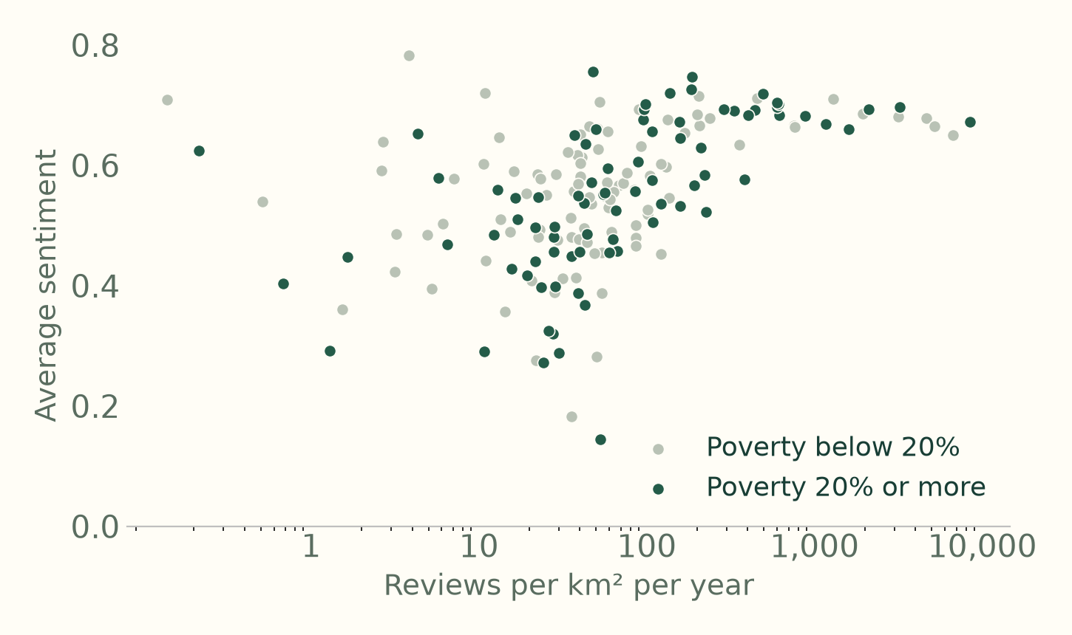
APPENDIX / SUPPORTING EVIDENCE
Review activity correlates with sentiment; poverty barely does
Average VADER sentiment by ZIP, 2019–21
ρ = 0.55
engagement and sentiment rise together
ρ = −0.04
poverty and sentiment barely move together. Green dots mark ZIPs with at least 20% poverty.
30%
of random reviews mention the surroundings at all
A2
Notes:
Second finding. Dense commercial ZIPs get good reviews, and poor ZIPs don't get worse ones. So low sentiment does not mark disadvantage. Only about three in ten reviews mention the surroundings at all. Anything civic has to be dug out of reviews written about businesses.

Slide 18
HOW DO WE SOLVE IT?
From a planning question to an area worth investigating
PHILADELPHIA / ZIP 19134
3.3%
56 of 1,702 reviews mention access
49%
historical poverty estimate
Use the evidence to focus an accessibility audit request.
Live demo: intreaction.github.io/neighborhood-sentiment-map
18
Notes:
12:25–13:55. Demo: choose Philadelphia, then ZIP 19134 and the access layer. Show 56/1,702 = 3.3% access mentions, alongside the 49.0% historical poverty estimate. Access mentions include praise as well as complaints, so this identifies a question for investigation rather than proving an access deficit. The income/poverty estimates describe the area, not reviewers. Then choose Trail / greenway and The Rail Park; inspect activity versus sentiment and a definition/reliability warning. Return to the planning scenario: the planner can choose what to investigate next. If the site fails, use this slide and the previous screenshots. Sources: web/place-areas.json, 2019–21 reviews; ACS 2007–11. Leave 10–15 seconds for transitions.

Slide 19
APPENDIX / SUPPORTING EVIDENCE
Sources
NYC Mayor’s Office of Contract Services. Citywide Indicators Report FY2026, citywide procurement cycle times.
Federal Data Strategy. Practices 1, 4 and 33: data needs, decision-making and open access.
Federal Acquisition Regulation 12.202. Market research and description of agency need.
Yelp Open Dataset, January 2022 archive, used under the dataset terms
U.S. Census Bureau. American Community Survey 5-year estimates; TIGERweb ZCTA boundaries
Hutto, C. and Gilbert, E. (2014). VADER. ICWSM
Reimers, N. and Gurevych, I. (2019). Sentence-BERT. EMNLP. Grootendorst, M. (2022). BERTopic
Project repository, methodology and data: github.com/intreaction/neighborhood-sentiment-map
AI use: OpenAI Codex and Anthropic Claude helped write code, check analysis and draft text. Claude Opus produced the 731 validation labels, which human reviewers checked and found satisfactory. The team reviewed all of it and is responsible for the work
A3
Notes:
Appendix for questions. The last line is our AI-use disclosure. If asked who labeled the validation set, say Claude Opus labeled it from the text alone, without seeing our rules' output, and that human reviewers have checked the labels and found them satisfactory, as confirmed by the team.

Slide 20
APPENDIX / SUPPORTING EVIDENCE
Technical methods behind the evidence workflow
Method | Question it answers
VADER lexicon sentiment | How positive is a review or a clause?
Keyword and target rules | Is a comment about the area or the business? Which topic? Negative?
TF-IDF and NMF topics | What recurring language is there, without labels?
MiniLM BERT embeddings | What does a clause mean beyond its keywords? We use BERTopic and a classifier.
A4
Notes:
VADER comes from week two. TF-IDF builds on week one's text processing and week four's word vectors, and NMF finds topics in it. BERT embeddings with BERTopic come from week six and lab four. We wrote the clause rules ourselves. They decide whether a sentence is about the area or the business.

Slide 21
APPENDIX / SUPPORTING EVIDENCE
Clause rules separate a business from its street, but miss some complaints
Sentence | Topic | About | Tone | Verdict
"Parking is impossible on this street." | Parking | Area | Negative | Right
"The staff were rude but the park across the street is lovely." | Service; public space | Business; area | Negative; positive | Right
"Their bathroom was dirty." | Cleanliness | Business | Negative | Right
"Street parking was a nightmare, but the tacos made up for it." | Parking | Area | Neutral | Missed
A5
Notes:
Start with what the rules get right. They can split one sentence between the business and the street. Then show the miss. "Nightmare" is not on our complaint list, so the rule calls the sentence neutral. Slide 10 measures how often that happens.

